Slide 1
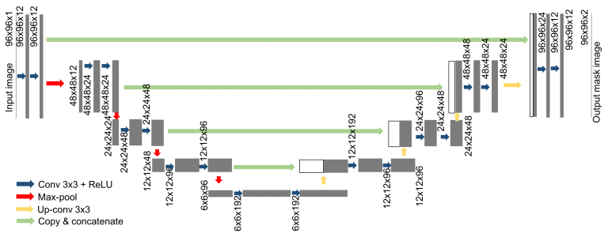
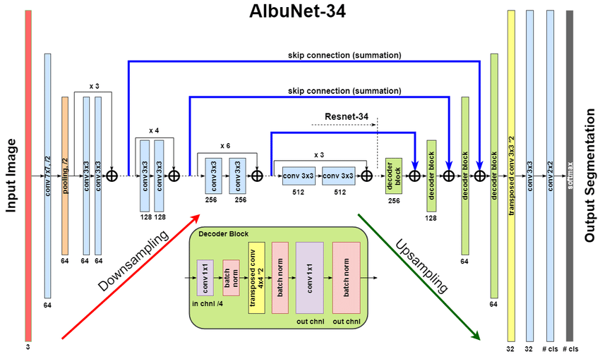
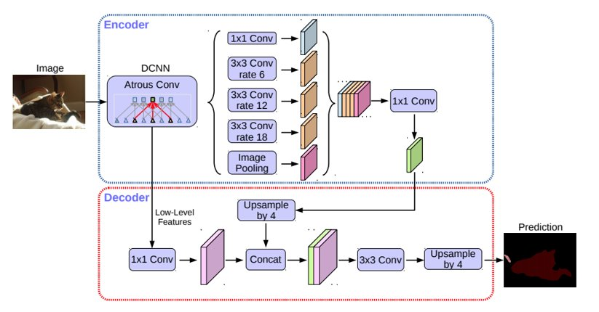
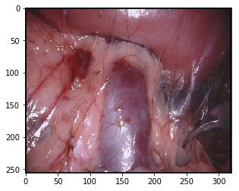
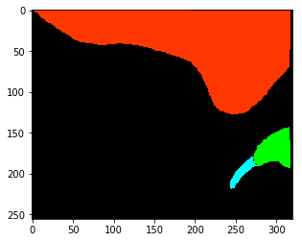
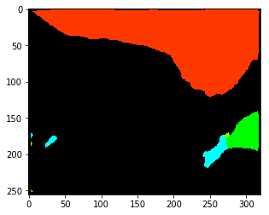
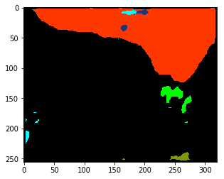
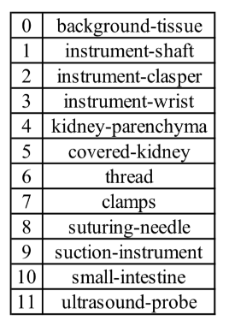
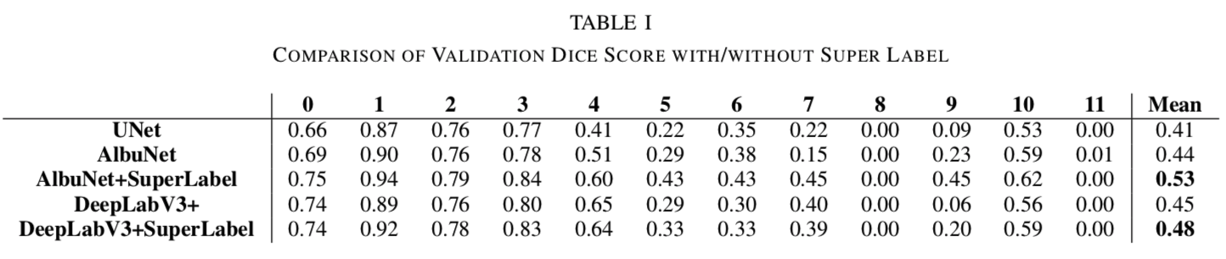
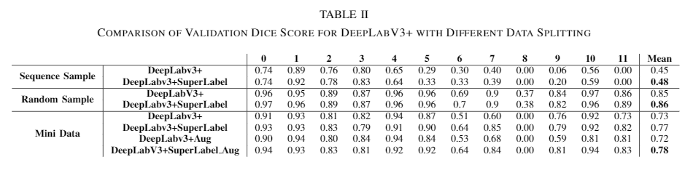
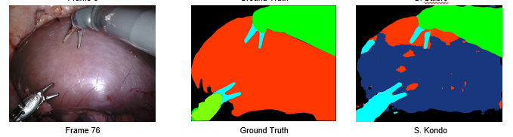
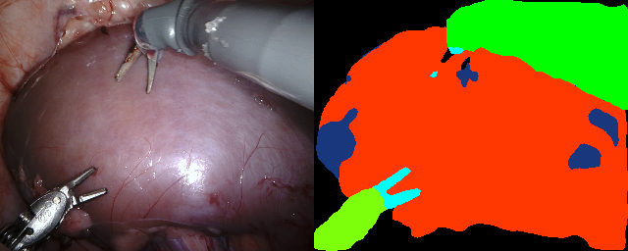
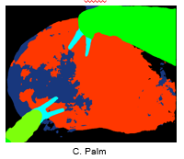
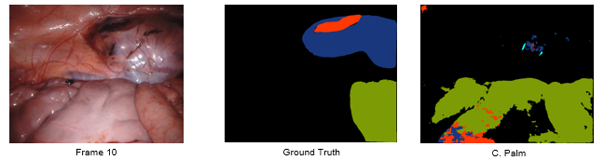
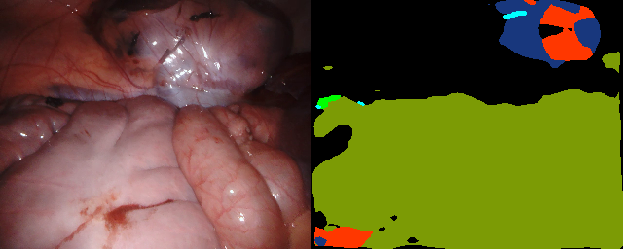
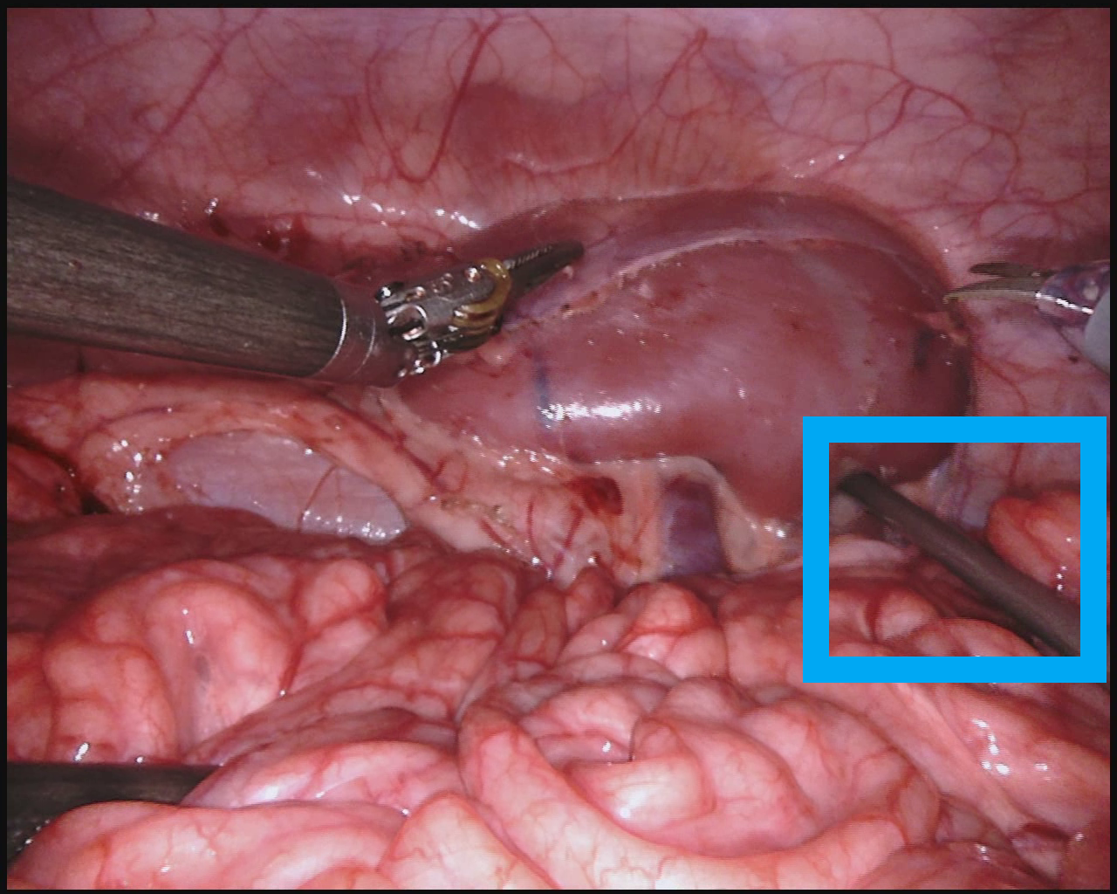
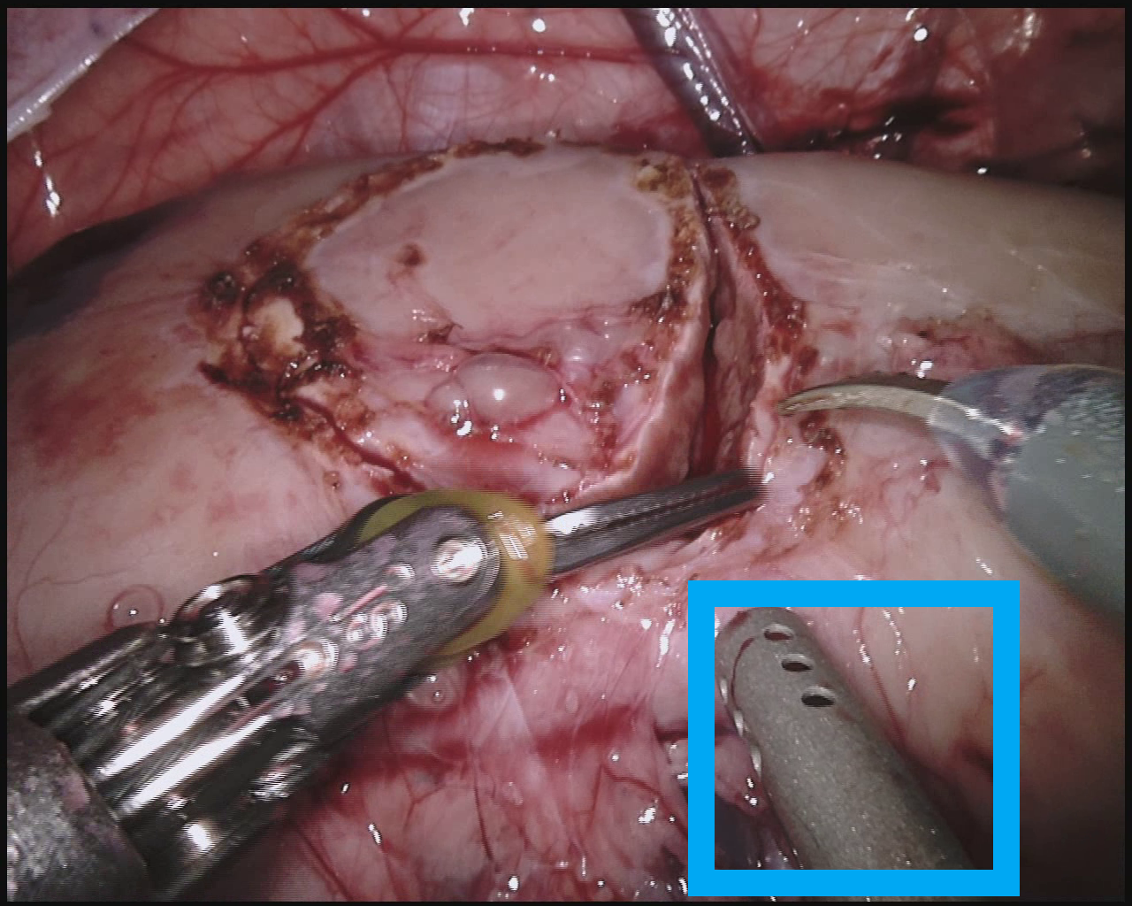
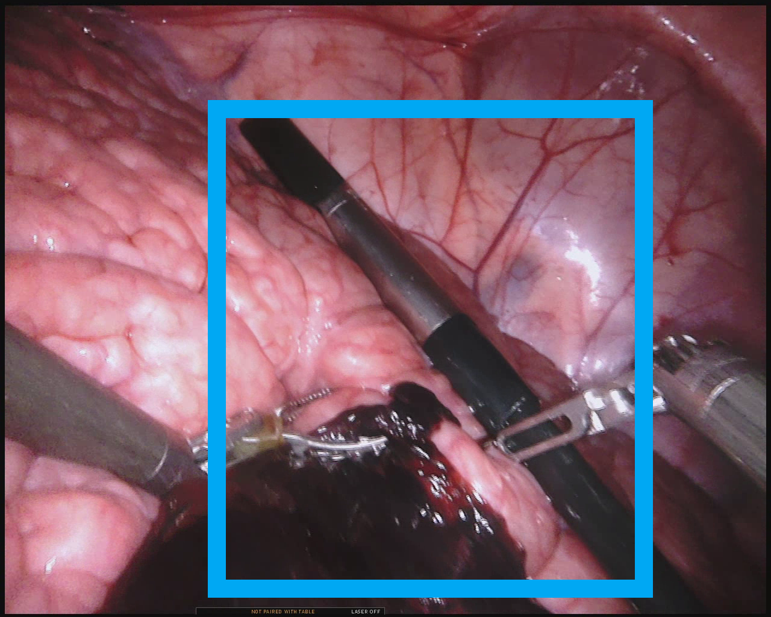
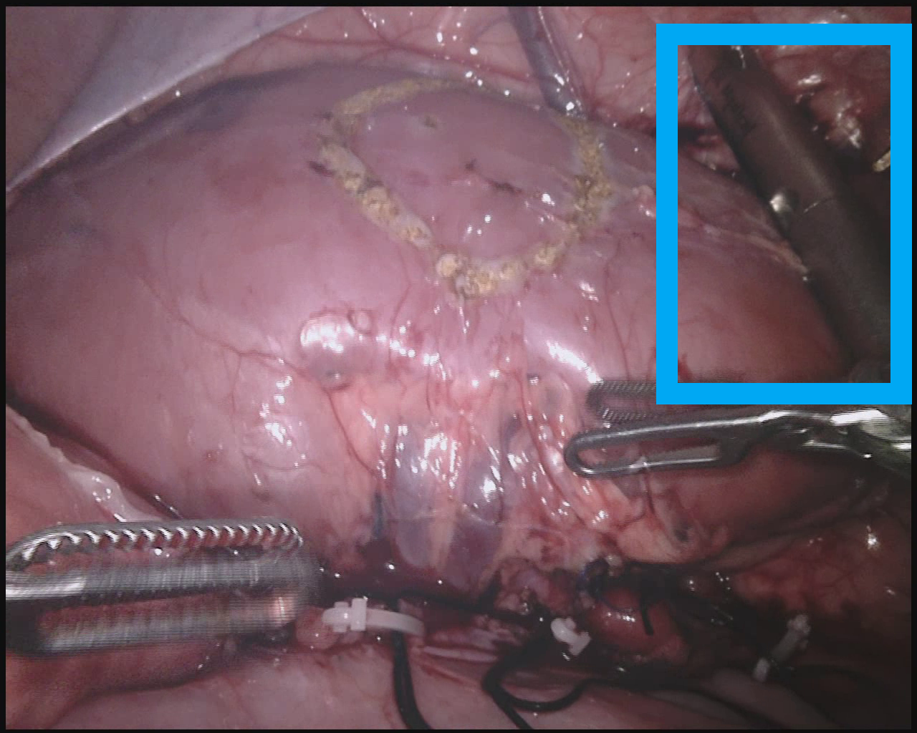
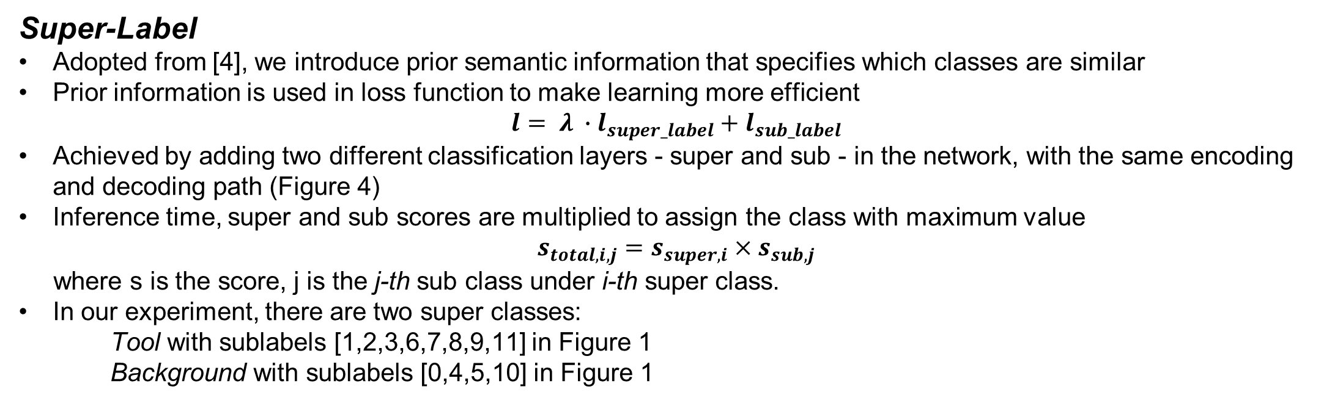
Semantics Segmentation for Surgical Scenes
Hao Ding, Mingyi Zheng, Zhaoshuo Li Mentor: Yeping Wang
Introduction
Experiment and Result
Robot-assisted surgeries are currently completely human teleoperated, given a prominent example of the da Vinci surgical robot developed by the Intuitive Surgical Inc. Being able to segment objects in a surgical scene will allow us to extend augmented reality and autonomy to robot-assisted surgeries.
We proposed an architecture design named Super-Label which can improve the segmentation result, and a data splitting method named Mini-Data to encourage the diversity of data. We have demonstrated the efficacy of our approaches with a mean dice score of 0.78 on only 20% of the total data. Our network generalizes well on unseen test data without ovefitting compared to previous year’s winner.
Experiment Setup
Hyper Parameters: as shown in Figure 5
Sequence Sample: Sequences 4,5,11 left out for validation, serves as lower limit
Random Sample: Split the data by randomly leaving 20% frames out for validation, serves as upper limit
Mini Data: uniformly sampled 20% of frames from each video sequence
Batch size | 10
Epoch with augmentation | 60
Epoch without augmentation | 30
Learning rate | 0.001
Optimizer | Adam
Weight Decay | 0.0005
Scheduler LR decay per epoch | 0.95
Super class weight | 0.5
Super-Label Result
The dice score of AlbuNet and DeepLabV3+ can be increased by 0.09 and 0.03 with Super- Label (TABLE I)
In the extreme case, the Super-Label approach increases the dice score by 0.24 for an unseen validation image during our experiment.
Sparse random segmentation is discouraged and uniformity is encouraged due to prior information (Figure 7).
AlbuNet also outperforms the DeepLabV3+ due to a shallower network, therefore less prone to overfitting
Mini-Data Result
With 20% of the data, the Super-Label is able to segment the rest of the video sequence with dice score 0.78, which is only 0.09 less than the best performance (TABLE II Row 4,8).
In the Mini-Data, the DeepLabV3+ with Super-Label outperforms DeepLabV3+ by 0.04 without augmentation and 0.06 with augmentation (TABLE II Row 5,6,7,8).
Small objects with only few pixels, such as the needle class (only 9 frames containing this classes, with a total of 4754 pixels), we only successfully segmented it with the Random Sample data splitting technique.
More data is beneficial for learning small objects, for which augmentation and increased dice loss weight could not help.
Architecture
Figure 5: Hyperparameters
U-Net [1]: A simplified U-Net is implemented for our project, which has 3x max-pooling layers and 3x up-conv layers.
AlbuNet34 [2]: similar to U-Net, except that after down-sampling, the fully-connected layers in the bottleneck part of the network is replaced with a pre-trained ResNet34 before the fully-connected layers.
DeepLabV3+ [3]: use a tunable dilated convolution called ASPP and skip-connections to concatenate encoding and decoding features. ResNet101 is used in our project as backbone.
Figure 2: U-Net
Figure 3: AlbuNet
Figure 4: DeepLabV3+
Data and Augmentation
(a)
(b)
(c)
(d)
MICCAI EndoVis2018:
15 sequences of video sampled at 5 Hz, each sequence containing 149 frames, totaling 2235 images
Partial nephrectomy in porcine lab
12 categories of objects shown in Figure 1
Spatial Augmentation:
Resized to 320x256 from 1280x1024
Horizontal flip
Affine transformation with 0.1 scale limit, 0.1 shift limit and 15 degrees rotation limit
Image Augmentation:
Cutout blocks
Random brightness, contrast, and HSV
Random spotlight
Motion blur
Figure 7: Example outputs with and without Super-Label. (a)(b) Input and label images, (c) output from models with Super-Label (d) output from models without Super-Label.
Figure 1: Object classes in EndoVis 2018
Methodology
Super Label + Mini Data
Previous year’s winner
Figure 4: Super-Label Network+
Figure 8: Comparison with previous year’s winner
Super-Label
Adopted from [4], we introduce prior semantic information that specifies which classes are similar
Prior information is used in loss function to make learning more efficient
$$l= λ ∙l_{super_label}+l_{sub_label}$$
Achieved by adding two different classification layers - super and sub - in the network, with the same encoding and decoding path (Figure 4)
Inference time, super and sub scores are multiplied to assign the class with maximum value
$$s_{total,i,j}=s_{super,i}×s_{sub,j}$$
where s is the score, j is the j-th sub class under i-th super class.
In our experiment, there are two super classes:
Tool with sublabels [1,2,3,6,7,8,9,11] in Figure 1
Background with sublabels [0,4,5,10] in Figure 1
Future Work
Future Direction
3D U-Net, by incorporating temporal information
Performance against the full resolution images
Quantitative evaluation against test data (due to lack of test data ground truth)
References
Mini-Data
Challenge to predict an object never seen due to the limited training data available
Randomly sampling frames from all video sequences and validate on other frames produce good result (dice=0.86, TABLE II Row 4), indicating strong sign of overfitting
Randomly sampling video sequences and validate on other sequences produce bad result (dice=0.53, TABLE I Row 3), indicating distinct distribution of data (Figure 6)
Thus, we proposed to split data and validation by sampling only 20% of a given video sequence and generalizing the network to the rest of 80% in order to include more diversity with the same amount of annotated data.
[1] O. Ronneberger, P. Fischer, and T. Brox, “U-net: Convolutional net- works for biomedical image segmentation,” in International Confer- ence on Medical image computing and computer-assisted intervention. Springer, 2015, pp. 234–241.
[2] A. A. Shvets, V. I. Iglovikov, A. Rakhlin, and A. A. Kalinin, “An- giodysplasia detection and localization using deep convolutional neural networks,” in 2018 17th IEEE International Conference on Machine Learning and Applications (ICMLA). IEEE, 2018, pp. 612–617.
[3] L.-C.Chen,Y.Zhu,G.Papandreou,F.Schroff,andH.Adam,“Encoder- decoder with atrous separable convolution for semantic image segmen- tation,” in Proceedings of the European Conference on Computer Vision (ECCV), 2018, pp. 801–818.
[4] B. Singh, H. Li, A. Sharma, and L. S. Davis, “R-fcn-3000 at 30fps: Decoupling detection and classification,” in Proceedings of the IEEE Conference on Computer Vision and Pattern Recognition, 2018, pp. 1081–1090.
(a)
(b)
(c)
(d)
Figure 6: Example images from training and validation set with objects of interest enclosed in blue rectangles. (a)(b) Training and validation images of the suction tool, (c)(d) Training and validation image of the ultrasound probe

